Slide 1


Emancipatory Information Retrieval
Bhaskar Mitra
Microsoft Research
@bmitra.bsky.social
* The views expressed in this talk are my own and do not reflect that of any institutions I am affiliated with.

Slide 2

Information retrieval (IR) is the study of tools and methods for satisfying people’s information need by finding relevant information—e.g., search engines and recommender systems
IR, a field in computing, has roots in library science and linguistics and have traditionally interacted with and been informed by other fields such as information science (IS), human-computer interaction (HCI), natural language processing (NLP), and machine learning (ML)

Slide 3
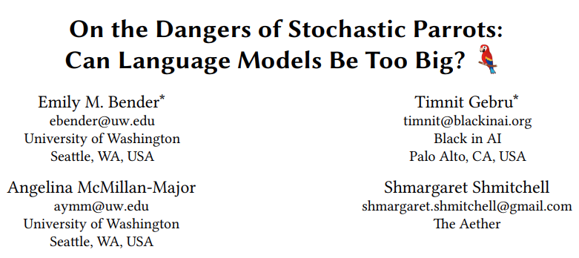
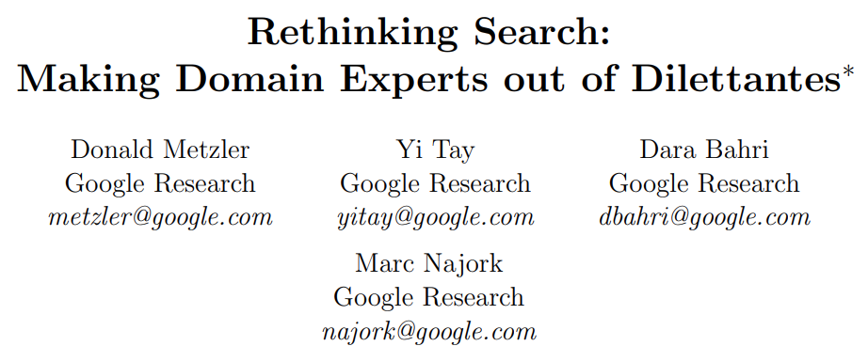
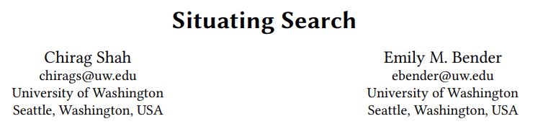
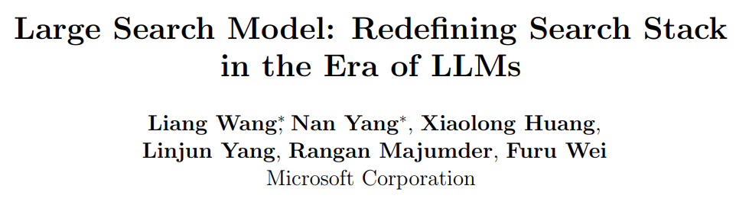
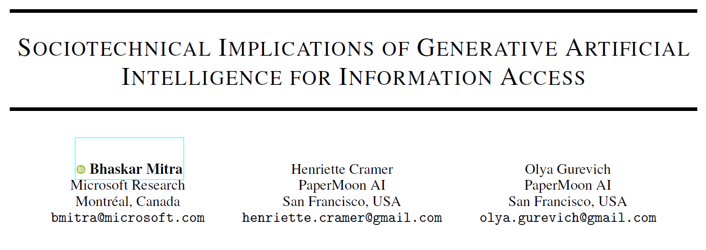



IR is undergoing transformative changes The tale of two perspectives on IR in the era of generative AI
Help realize new information access modalities; reimagine the information retrieval stack; estimate relevance better than crowdworkers
Disrupts information ecosystems; increases misinformation; concentrates power; reproduces historical marginalizations; accelerates climate change
Notes:
Risks of generative AI in information access:
Disrupt our online information ecosystem
Act as misinformation superspreaders
Concentrate power
Reproduce historical marginalization
A heavy price tag of accelerating anthropogenic climate change

Slide 4


The IR researcher’s dilemma
What AI makes plausible
What the world needs
Generative AI may enable new ways in which we access information; there is huge push towards AI in industry, government, and even academia; and working on AI is associated with high prestige and potential for big rewards
Our world is facing several mutually reinforcing crises (e.g., pandemic, climate change, rise in fascism, increasing global conflicts, and growing global inequity) each of which intersects with concerns of social justice and emancipation
What should IR focus on?

Slide 5
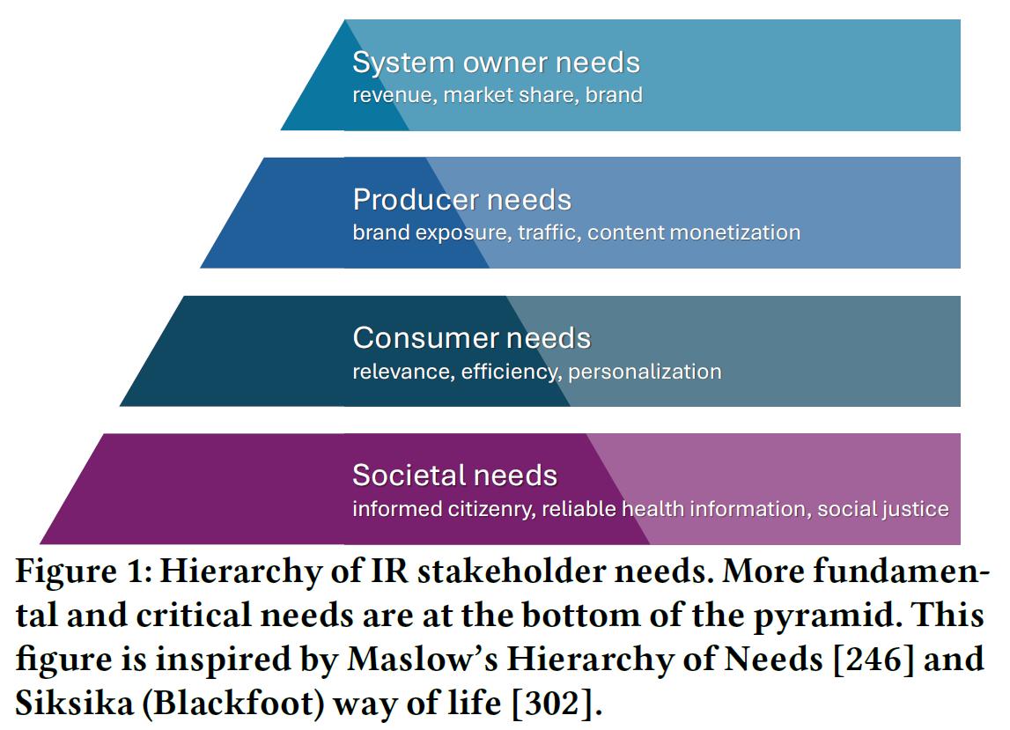
Who are we building for?
Traditionally, IR has placed a strong emphasis on understanding and optimizing for the needs of the users (consumers)
In industry, there is also salient emphasis on the needs of the system / platform owners and that of the content producers and publishers
But limited attention has been given to optimizing IR systems for desirable societal outcomes; when societal concerns are surfaced, they are typically framed through narrow demands for “more fairness” and “less misinformation”
Mitra. Search and Society: Reimagining Information Access for Radical Futures. In The Information Retrieval Research Journal (IRRJ), 2025.

Slide 6
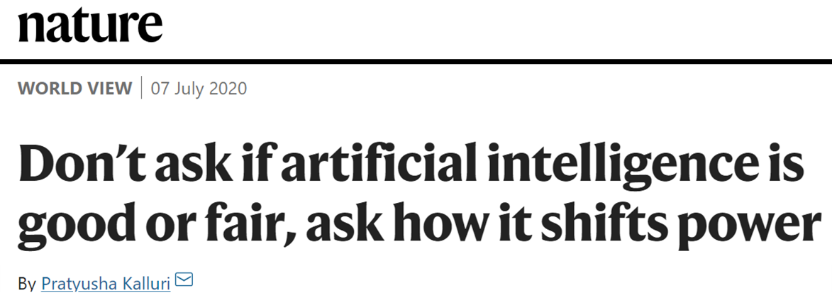
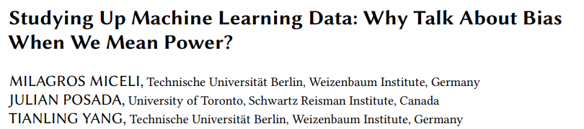
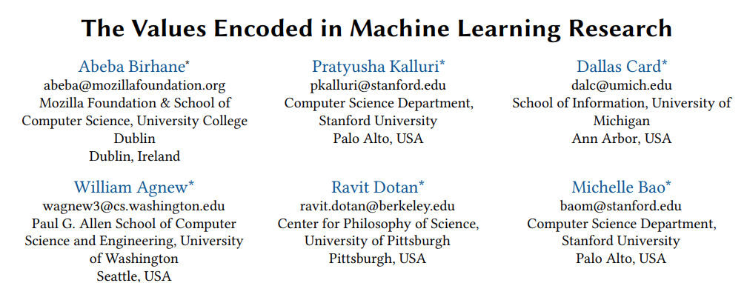
Re-interrogating fairness and bias frames in Computer Science
If you work in responsible AI or any related area, does it feel like you are stuck in never-ending loops of enumerating the risks of technologies that are constantly emerging ?
Are we often mis-framing how technology impacts power and justice as concerns of algorithmic fairness and bias that detract from underlying social justice issues?
Do the “responsible AI” and “responsible IR” frames themselves presuppose that these technologies can be made responsible, and that it is just the technology, not the power concentration by those building and wielding it, that should be challenged?

Slide 7
Provocation for this talk
What framing of IR research can motivate the field to reach out beyond its disciplinary boundaries and work with other scholars, experts, and community advocates to address the critical societal needs of our time in a way that is both informed by historical struggles for justice and emancipation and situated in ongoing social movements?

Slide 8
e.g., colonialism, racism, patriarchy, casteism, transphobia, ableism, …
Emancipatory IR is the study and development of information access methods that challenge all forms of human oppression and situates its activities within broader collective emancipatory praxis
Discourages non-performative academic gaze, urges this research to be situated in movement building, and calls for the recognizing the role of movement building in this research
Signifies the moral concerns of universal humanization of all peoples and the elimination of oppression to create the conditions under which we can collectively flourish
Mitra. Emancipatory Information Retrieval. Under review, 2025.

Slide 9
Why is emancipation a relevant concern for IR?
Access to information is critical to collective sense-making of our place and relationships in this world; therefore, throughout history authoritarian forces have tried to control what information is disseminated and how; and information access media have been a site of conflict between liberation and oppression
For emancipatory IR, the challenge is to radically reimagine new ways to:
Experience information—e.g., in ways that uplift marginalized voices and promote emancipatory pedagogy
Design platforms—e.g., decentralization to safeguard against platform capture
Reduce human and ecological cost of development—e.g., countering environmental impact and appropriation of data labor in the development of generative AI
Each of the above, raises new sociotechnical challenges and research questions for the field
We want to challenge the field to move beyond the restrictive view of IR (algorithmic advances as measurable on shared benchmarks and leaderboards) to a more expansive view of IR (situating information access as a vehicle for social good)

Slide 10

A framework of Practices, Projects, and Provocations for emancipatory IR
Diagnose and critique ◦◦◦◦◦ Imagine viable alternatives ◦◦◦◦◦ Elaborate theories of change ◦◦◦◦◦
Community building and organizing
Safeguard against surveillance
Promote emancipatory pedagogy
Safeguard against dehumanization and inequitable outcomes
Safeguard against capture
Safeguard against manipulation
Mitigate ecological and human costs
Provocations for emancipatory IR
Mitra. Emancipatory Information Retrieval. Under review, 2025.

Slide 11



Practices of emancipatory IR
Diagnose and critique
Identify ways in which existing IR methods and systems, the cost of IR R&D, and the arrangements within the IR community may contribute systemic harms and impede emancipatory struggles
Imagine viable alternative futures
Rid ourselves of the “tyranny of dominant imaginaries” and reimagine desirable, viable, and achievable alternatives for future information experiences
Elaborate theories of change
Realize alternative futures in the face of current realities by developing new research agendas and exploring new arrangements within the IR community and new relationships with other institutions (e.g., industry and government)
Mitra. Emancipatory Information Retrieval. Under review, 2025.

Slide 12
Practices of emancipatory IR
Diagnose and critique
Identify ways in which existing IR methods and systems, the cost of IR R&D, and the arrangements within the IR community may contribute systemic harms and impede emancipatory struggles
Imagine viable alternative futures
Rid ourselves of the “tyranny of dominant imaginaries” and reimagine desirable, viable, and achievable alternatives for future information experiences
Elaborate theories of change
Realize alternative futures in the face of current realities by developing new research agendas and exploring new arrangements within the IR community and new relationships with other institutions (e.g., industry and government)
Mitra. Emancipatory Information Retrieval. Under review, 2025.

Slide 13

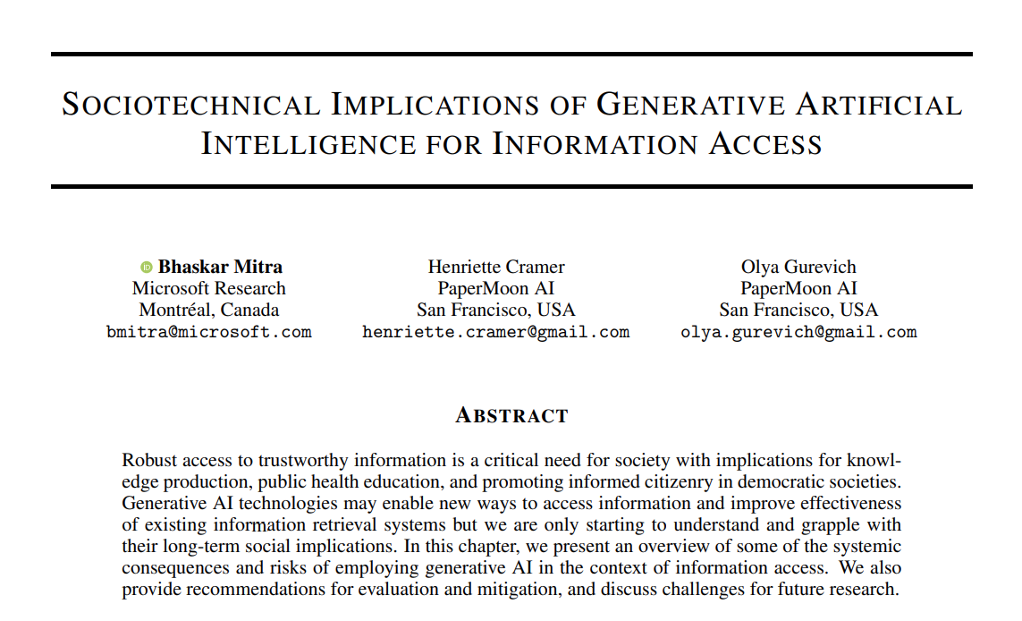
Diagnose and critique
https://link.springer.com/book/9783031731464
Mitra, Cramer, & Gurevich. Sociotechnical implications of generative artificial intelligence for information access. Book chapter, Springer Nature, 2025.

Slide 14
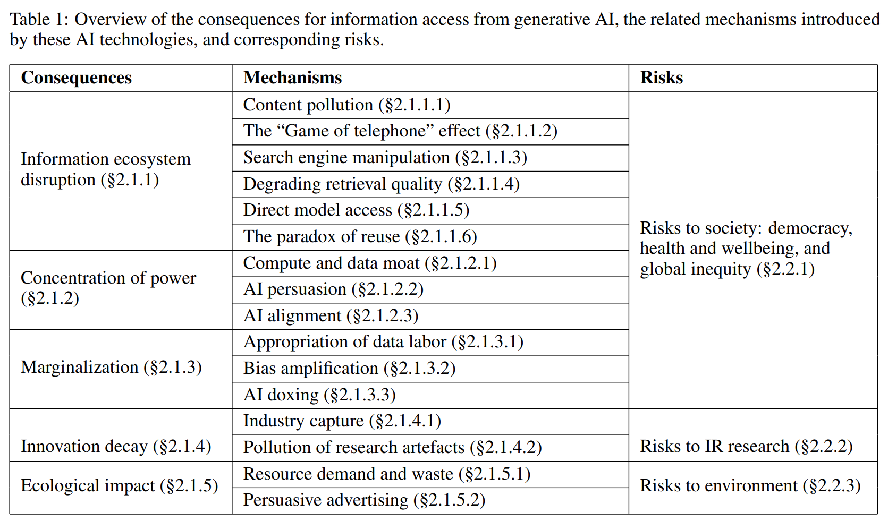
Sociotechnical implications of generative AI for information access
Diagnose and critique
A.K.A “hallucinations”,
we avoid that term as it is anthropomorphizing
Mitra, Cramer, & Gurevich. Sociotechnical implications of generative artificial intelligence for information access. Book chapter, Springer Nature, 2025.
Gausen, Mitra, & Lindley. A Framework for Exploring the Consequences of AI-Mediated Enterprise Knowledge Access and Identifying Risks to Workers. In Proc. FAccT, 2024.
Notes:
How generative AI may potentially disrupt how content is produced, consumed, monetized, and manipulated towards specific ends and how different actors and stakeholders operate and related with each other
How they shift and concentrate power while further marginalizing those at the periphery
Impact on academic research and innovation itself as well as the ecological costs of our current AI technology trends

Slide 15
Examples of mechanisms
Diagnose and critique
Information ecosystem disruption may be cause by several mechanisms including LLMs lowering the cost of generating low-quality content (content pollution), inserting LLMs between users and search results shifting the responsibility of information inspection and interpretation to the LLM (“game of telephone” effect), and reducing traffic to websites on whose data LLMs are trained (paradox of reuse).
Marginalization may result not only from bias amplification but also from the appropriation of data labor from uncompensated writers, programmers, and peer production communities and under-compensated crowdworkers; AI data labor dynamics reinforces structures of racial capitalism and coloniality
Concentration of power may result from compute and data moats in the hands of few institutions and the potential future application of generative AI for hyper-personalized hyper-persuasive ads (AI persuasion)
Mitra, Cramer, & Gurevich. Sociotechnical implications of generative artificial intelligence for information access. Book chapter, Springer Nature, 2025.

Slide 16
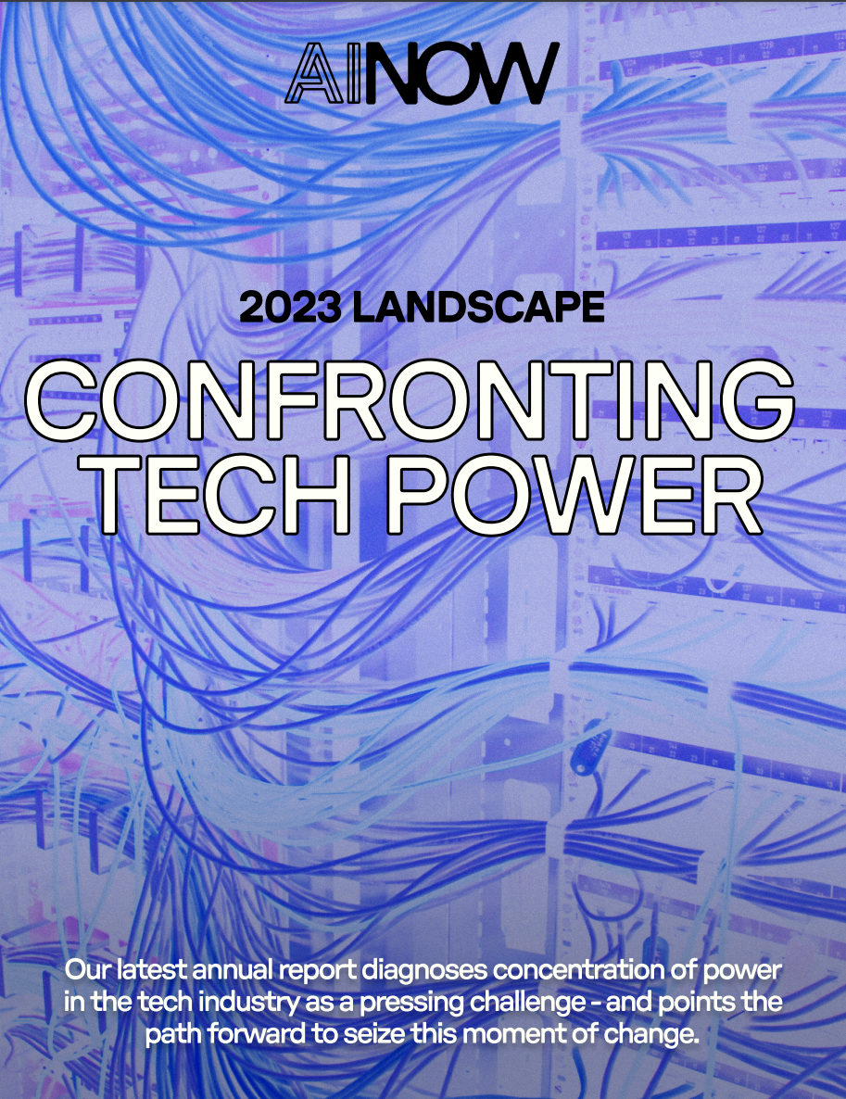
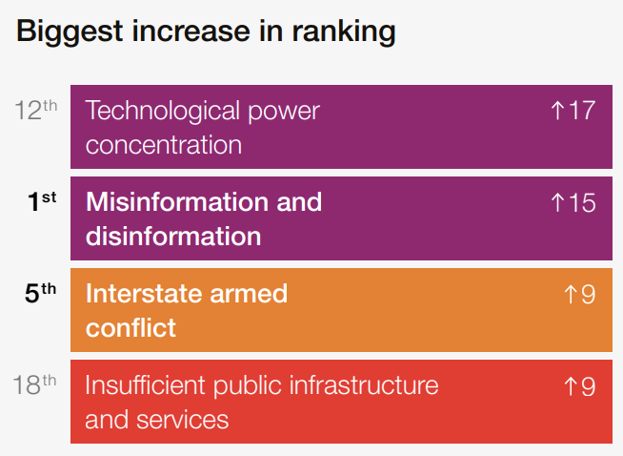

On technological power concentration
Diagnose and critique
Annual change in global risk perceptions over the short term (2 years)
Mitra, Cramer, & Gurevich. Sociotechnical implications of generative artificial intelligence for information access. Book chapter, Springer Nature, 2025.
Notes:
Not just the technologies but the narratives (both the hype and the fear-mongering) around them questionably bolsters claims of “foundational” advancements
Report from the research institute AI Now asserts the concentration of economic and political power in the hands of the tech industry as the core challenge posed by AI
2024 edition of the World Economic Forum’s Global Risks Report lists “technological power concentration” as the 12th top global risk for the coming decade and as the biggest upward mover in their annual ranking of global risks compared to the previous year.

Slide 17
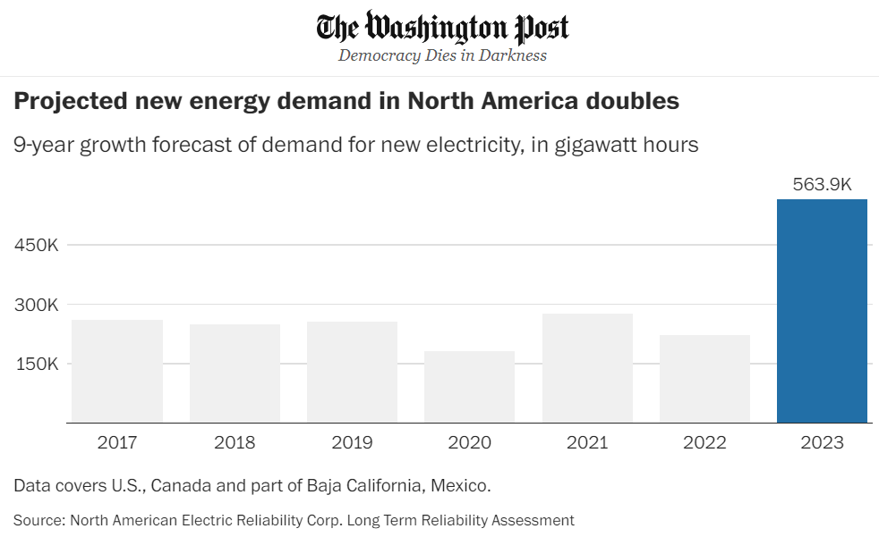

The ecological cost of AI
Diagnose and critique
Computing power being utilized for deep learning research has been doubling every 3.4 months since 2012
In US, data centers consumed more than 4% of total national electricity in 2022, and that number is projected to grow to 6% by 2026
Another study estimates that by 2040 Information and Communications Technology industry alone would account for 14% of global emissions
By 2027, global AI demand may be responsible for withdrawal of 1.1 − 1.7 trillion gallons of fresh water annually
Serious concern also revolve around the rising levels of electronic wastes
Mitra, Cramer, & Gurevich. Sociotechnical implications of generative artificial intelligence for information access. Book chapter, Springer Nature, 2025.
Notes:
Jevons paradox

Slide 18
Practices of emancipatory IR
Diagnose and critique
Identify ways in which existing IR methods and systems, the cost of IR R&D, and the arrangements within the IR community may contribute systemic harms and impede emancipatory struggles
Imagine viable alternative futures
Rid ourselves of the “tyranny of dominant imaginaries” and reimagine desirable, viable, and achievable alternatives for future information experiences
Elaborate theories of change
Realize alternative futures in the face of current realities by developing new research agendas and exploring new arrangements within the IR community and new relationships with other institutions (e.g., industry and government)
Mitra. Emancipatory Information Retrieval. Under review, 2025.

Slide 19

Sociotechnical imaginaries
Imagine viable alternative futures
Diagnose and critique
“Visions of desirable futures, animated by shared understandings of forms of social life and social order attainable through, and supportive of, advances in science and technology”
~Jasanoff and Kim (2015)
Whose sociotechnical imaginaries are granted normative status and what myriad of radically alternative futures are we overlooking?
How does increasing dominance of established for-profit platforms over academic research influences and/or homogenizes the kinds of IR systems we build?
What would information access systems look like if designed for futures informed by feminist, queer, decolonial, anti-racist, anti-casteist, anti-ableist, and abolitionist thoughts?
Mitra. Search and Society: Reimagining Information Access for Radical Futures. In The Information Retrieval Research Journal (IRRJ), 2025.

Slide 20

Imagine viable alternative futures
Diagnose and critique
“The exercise of imagination is dangerous to those who profit from the way things are because it has the power to show that the way things are is not permanent, not universal, not necessary.”
– Ursula K. Le Guin

Slide 21
Proposal for design futuring
Imagine viable alternative futures
Diagnose and critique
Organize an inaugural workshop to pull together a seed community interested in this research direction that includes:
Series of talks covering critiques and provocations
Futuring session to radically reimagine IR systems and our relations with them
Sketch out paths to desired futures and identify problems and projects
Discuss how this research can be sustained (e.g., funding) and steps to safeguard against reprisal from whose power our research aims to challenge
Ideally, participation in the workshop should extend beyond IR researchers to include social science / HCI scholars and those with experiences in social justice organizing
Mitra. Emancipatory Information Retrieval. Under review, 2025.

Slide 22
Practices of emancipatory IR
Diagnose and critique
Identify ways in which existing IR methods and systems, the cost of IR R&D, and the arrangements within the IR community may contribute systemic harms and impede emancipatory struggles
Imagine viable alternative futures
Rid ourselves of the “tyranny of dominant imaginaries” and reimagine desirable, viable, and achievable alternatives for future information experiences
Elaborate theories of change
Realize alternative futures in the face of current realities by developing new research agendas and exploring new arrangements within the IR community and new relationships with other institutions (e.g., industry and government)
Mitra. Emancipatory Information Retrieval. Under review, 2025.

Slide 23







Potential projects for emancipatory IR
Safeguard against platform capture
Safeguard against surveillance
Safeguard against manipulation
Safeguard against dehumanization and inequitable outcomes
Promote emancipatory pedagogy
Visibilize and mitigate ecological and human costs
Community building and organizing
Mitra. Emancipatory Information Retrieval. Under review, 2025.

Slide 24
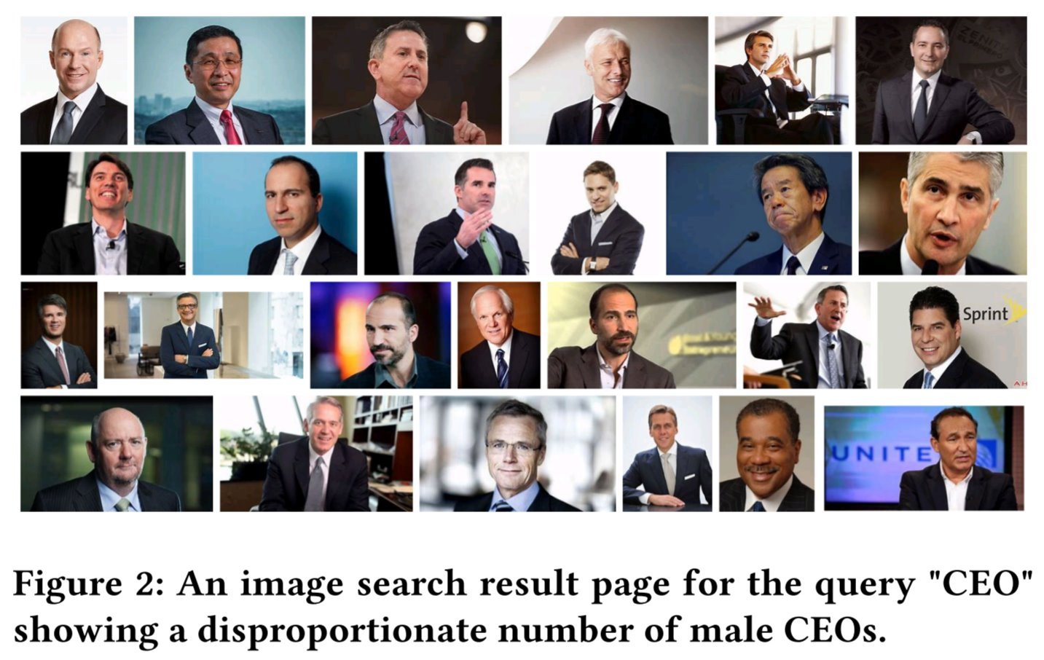
Search result pages as sites of emancipatory pedagogy
Promote emancipatory pedagogy
Instead of trying to algorithmically fix under-representation of women and people of color in image search results for occupational roles, can we reclaim that digital space as a site of resistance and emancipatory pedagogy by allowing feminist, queer, and anti-racist scholars, activists, and artists to create experiences that teach the history of these movements and struggles?
Mitra. Search and Society: Reimagining Information Access for Radical Futures. In The Information Retrieval Research Journal (IRRJ), 2025.

Slide 25
The criticality of transdisciplinary research and DEI
Community building and organizing
This is a call for collective struggle of solidarity with scholars from HCI, information sciences, media studies, design, social sciences, humanities, democratic theory, and critical theory, as well as legal and policy experts, civil rights and social justice activists, and artist; not for technosolutionism.
To challenge the homogeneity of the future imaginaries saliently bound by colonial, cisheteropatriarchal, and capitalist ways of knowing the world, we need broad and diverse participation from our community.
Inclusion of people without inclusion of their history, struggles, and politics is simply tokenism and epistemic injustice; we should go beyond Diversity and Inclusion (D&I), and enshrine as our goal Justice, Equity, and Diversity & Inclusivity (JEDI).
Mitra. Search and Society: Reimagining Information Access for Radical Futures. In The Information Retrieval Research Journal (IRRJ), 2025.
Notes:
We must approach these spaces with curiosity and humility; in recognition of our own incomplete understanding of the world; open to change and be changed by these encounters
We need to build scaffolding to bring the community along
To quote Keyes et al.: “This must be about more than just bodies: it is not diversity if we only accept marginalized people who are stripped of the epistemic models that underpin experiences of being Other, or have the work they draw from those models held to an unequal standard of legitimacy”

Slide 26
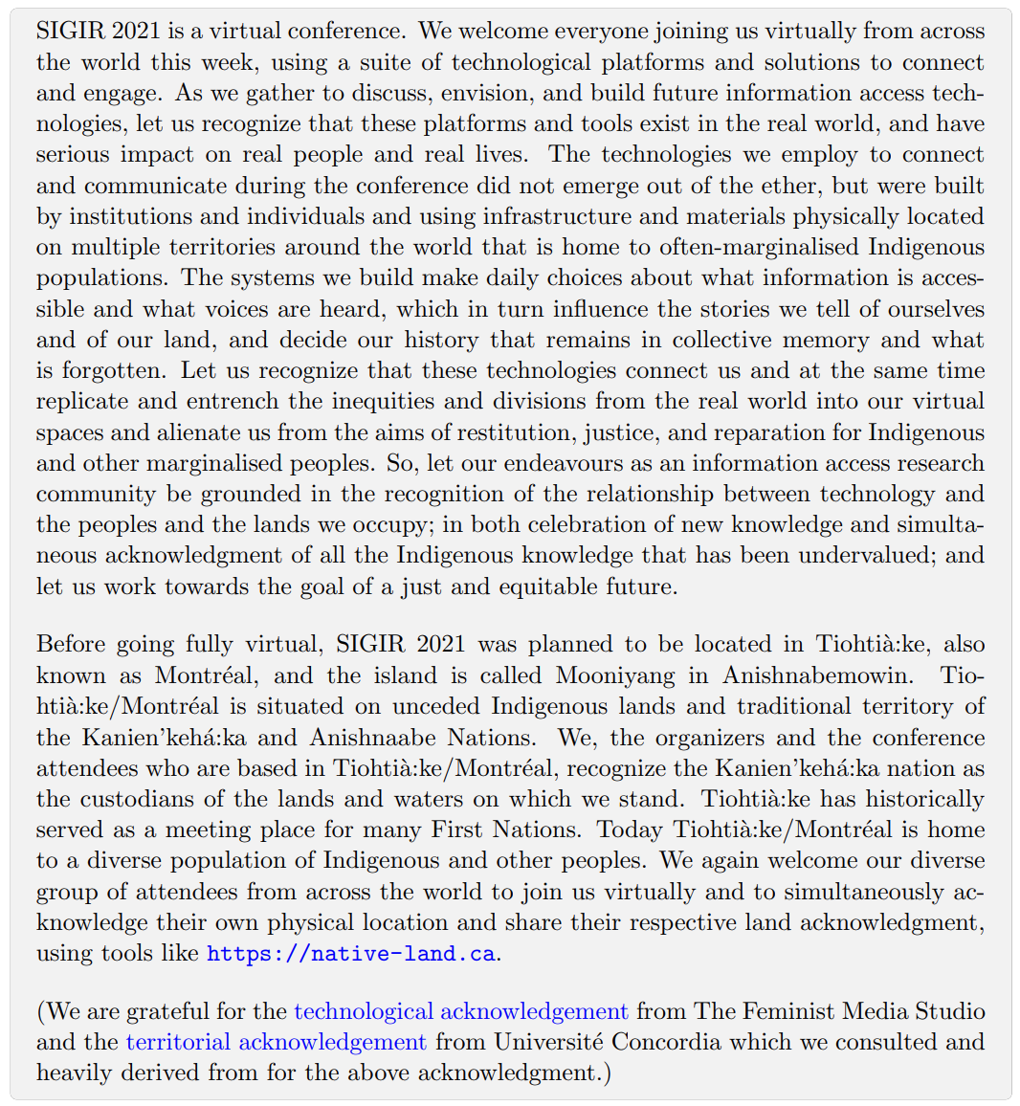
Practices to raise sociopolitical consciousness of the community
Community building and organizing
SIGIR’21 Technological acknowledgment
Practices like land acknowledgment can help draw attention to historical and ongoing injustices
However, such statements should be grounded in actionable critique of our own role and complicity in structures that oppress indigenous peoples
Shah et al. Report on the 44th International ACM SIGIR Conference on Research and Development in Information Retrieval (SIGIR 2021). In SIGIR Forum, ACM, 2022.

Slide 27



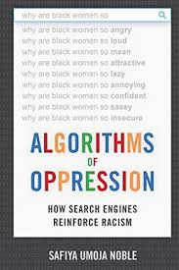
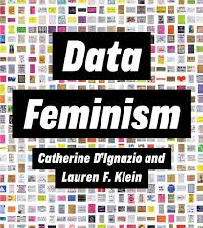





Community building and organizing
Book clubs and reading groups

Slide 28
Provocations to escape dominant imaginaries
How can feminist epistemology inform IR research?
How can queer epistemology inform IR research?
How can decolonial epistemology inform IR research?
How can abolitionist epistemology inform IR research?
How can anti-caste movements inform IR research?
How can disability justice movements inform IR research?
How can democratic theory inform IR research?
How can critical theory inform IR research?
What reflective practices can we operationalize to better understand and shape the values of our IR community?
Mitra. Emancipatory Information Retrieval. Under review, 2025.

Slide 29

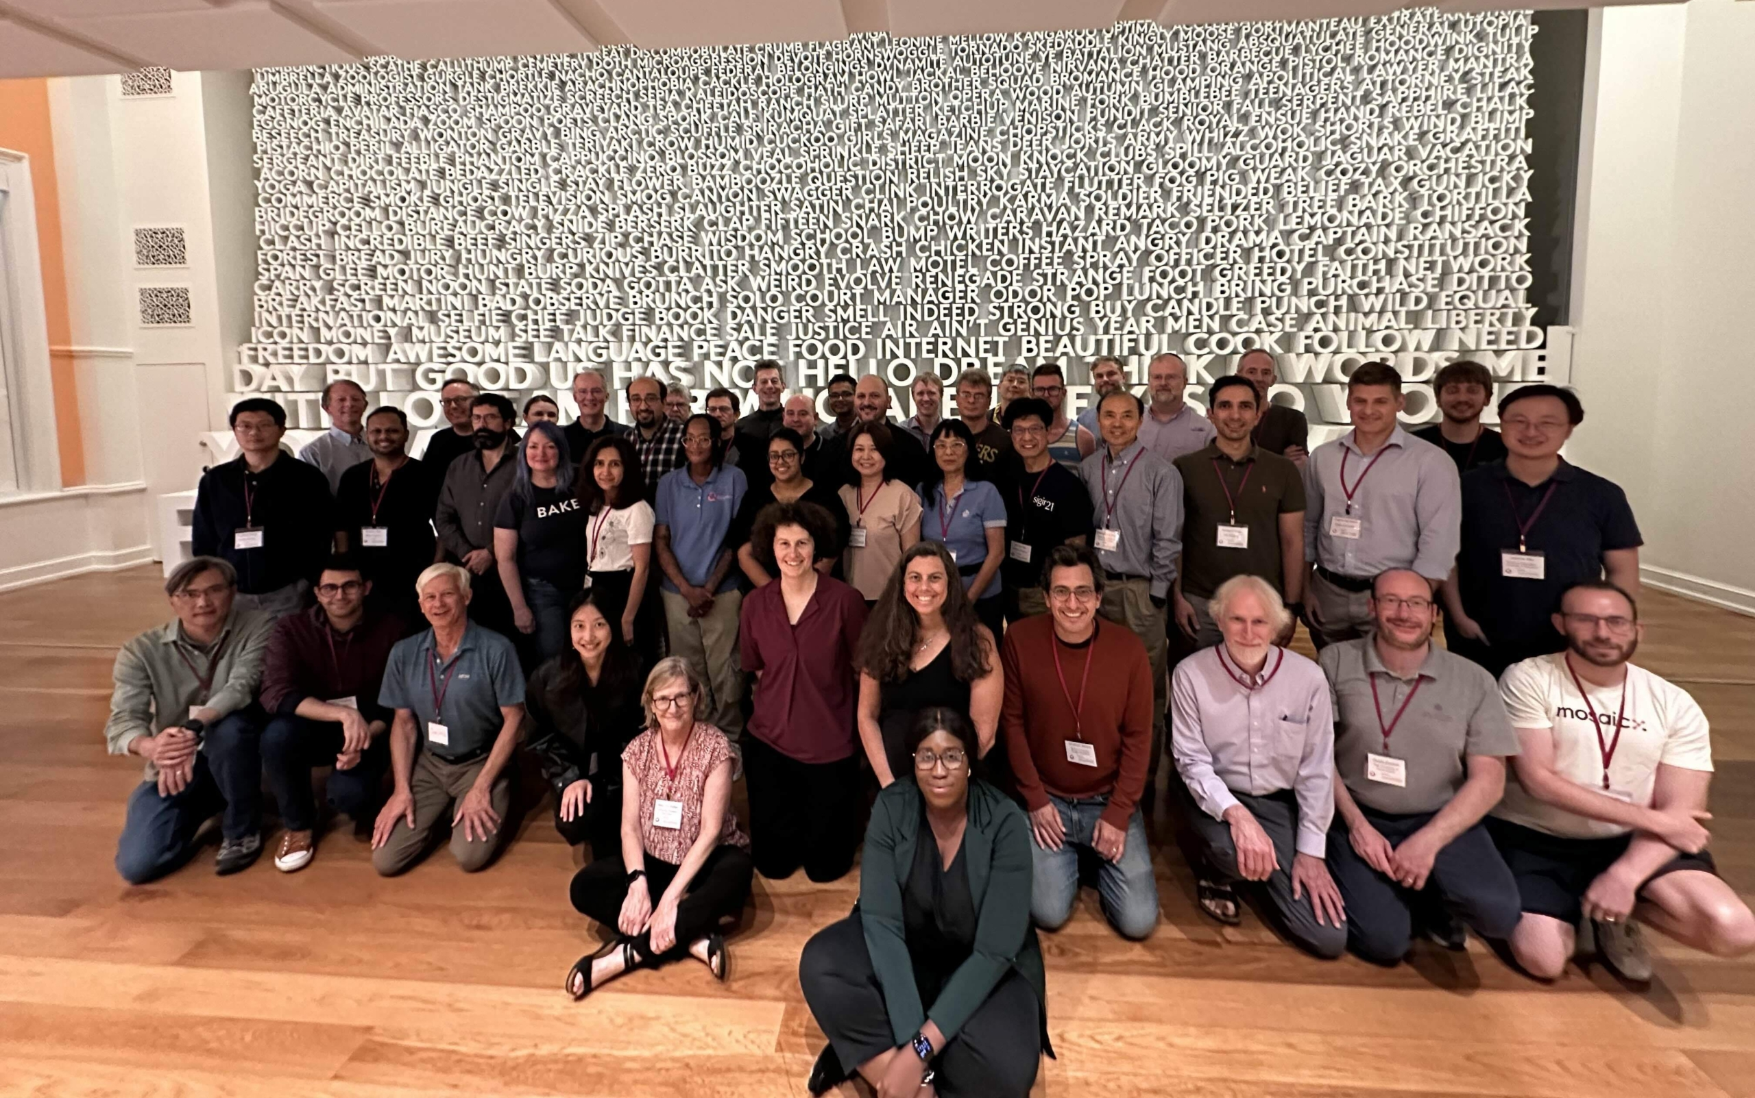
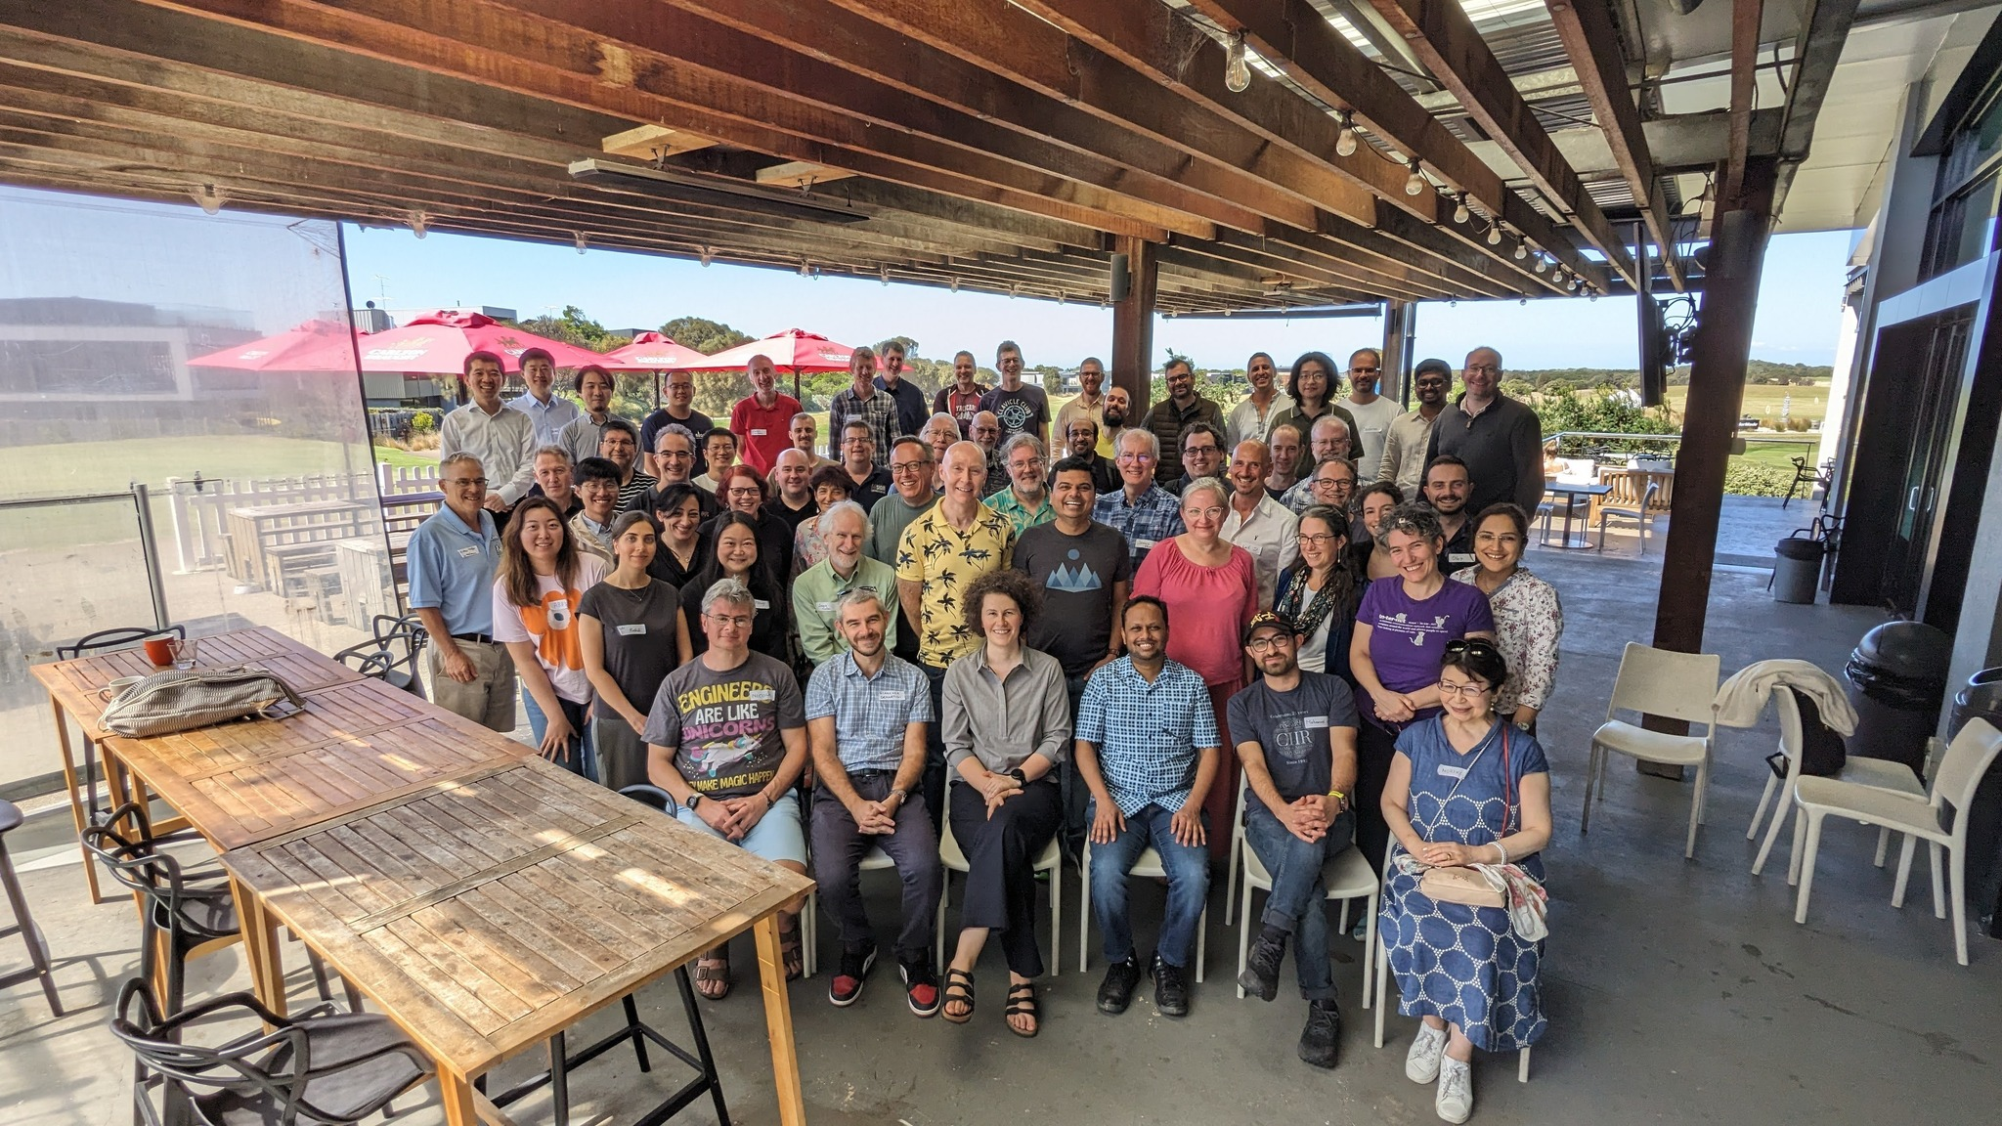
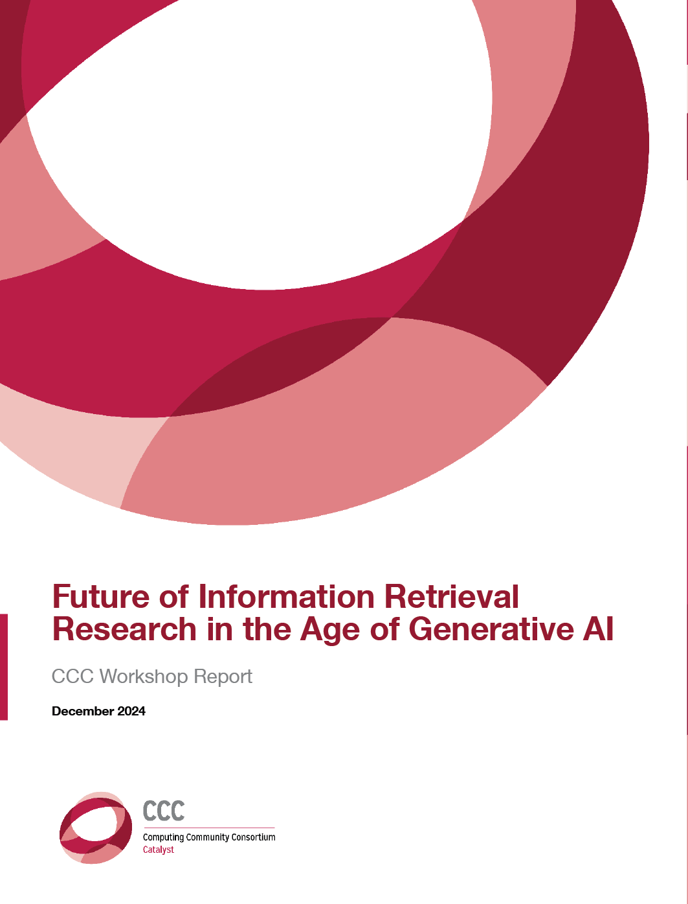
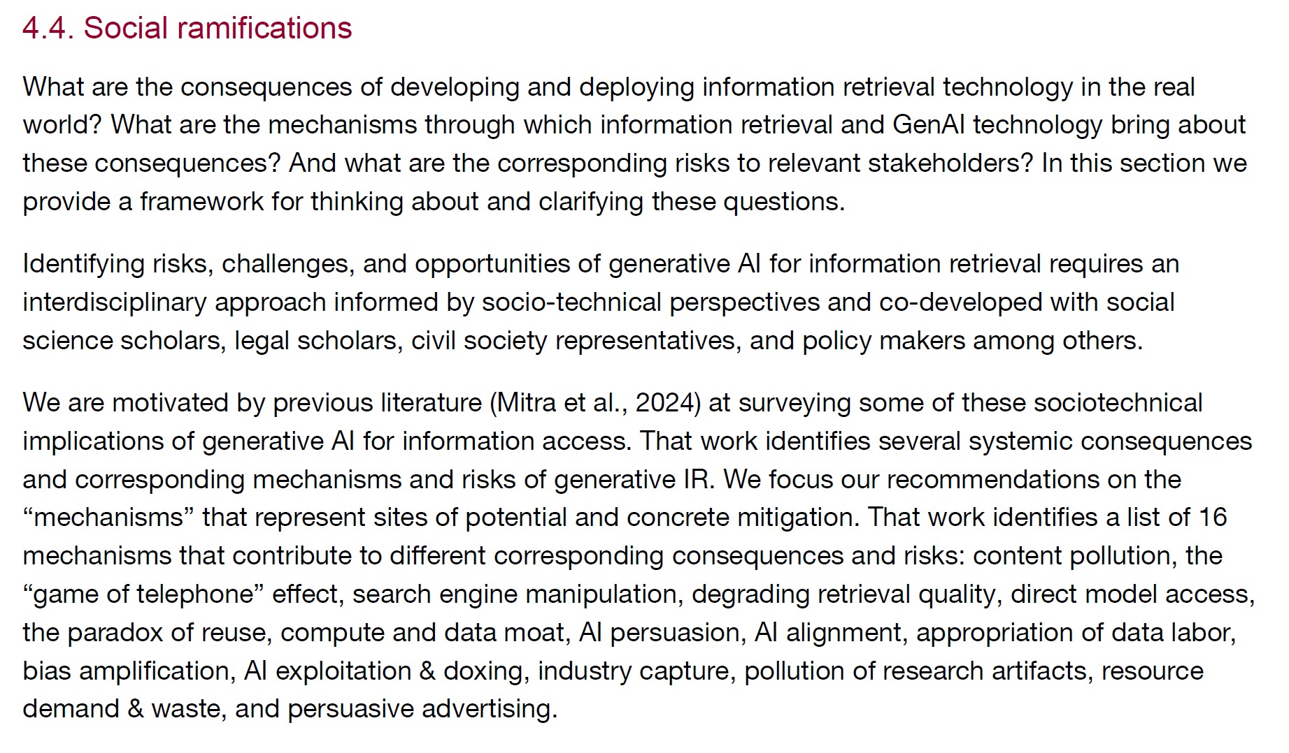
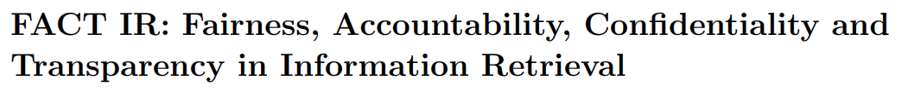

We are planting seeds
Future of Information Retrieval Research in the Age of Generative AI CCC Workshop
The 4th Strategic Workshop on Information Retrieval in Lorne (SWIRL)
(SWIRL’18)
(SWIRL’25)

Slide 30
Concluding thoughts
Emancipatory IR must challenge power. Whose power is our research challenging? Is our fairness and transparency research unintentionally giving legitimacy to systems that should be dismantled? How do we fund this research and protect the community from reprisal from those whose power and visions are challenged by this transformation?
Emancipatory IR must be movement building. What steps are we taking to organize the community to work towards emancipatory goals? How vital is this organizing to our research?
Emancipatory IR must prioritize praxis over proxies. Are we adequately emphasizing research activities and reflections directed at structural change over proxy metrics of success, e.g., SOTA / leaderboard rankings that do not translate to scientific or social progress?
“If you have come here to help me you are wasting your time, but if you have come because your liberation is bound up with mine, then let us work together.”
– Lilla Watson
and other members of an
Aboriginal Rights group in Queensland

Slide 31

“Another world is not only possible, she is on her way. On a quiet day, I can hear her breathing.”
– Arundhati Roy

Slide 32
References
Mitra. Emancipatory Information Retrieval. Under review, 2025.
Mitra. Search and Society: Reimagining Information Access for Radical Futures. In The Information Retrieval Research Journal (IRRJ), 2025.
Mitra, Cramer, & Gurevich. Sociotechnical implications of generative artificial intelligence for information access. Book chapter in Information Access in the Era of Generative AI, Springer Nature, 2025.
Gausen, Mitra, & Lindley. A Framework for Exploring the Consequences of AI-Mediated Enterprise Knowledge Access and Identifying Risks to Workers. In Proc. ACM FAccT, 2024.

